Slide 1
Basic Concepts
Process:
A series of steps involving activities, constraints, and resources that produce an intended output of some kind.

Slide 2
Software Process
The systematic approach that is used in software engineering is sometimes called a software process.
A software process is a sequence of activities that leads to the production of a software product.
There are four fundamental activities that are common to all software processes.

Slide 3
Software Process
Software specification: The functionality of the software and constraints on its operation must be defined.
Software design and implementation (Software development): The software to meet the specification must be produced.
Software validation: The software must be validated to ensure that it does what the customer wants.
Software evolution: Where the s/w is modified to reflect changing customer and market requirement. The software must evolve to meet changing customer needs.

Slide 4
Software Process
They are complex activities in themselves and include sub-activities such as:
requirements validation
architectural design
unit testing
maintenance
There are also supporting process activities such as documentation and software configuration management

Slide 5
Software Process
The activities in these processes such as specifying a data model, designing a user interface, etc., and the ordering of these activities.
However, as well as activities, process description may also include:
Products
Roles
Pre- and post-conditions

Slide 6
Software Process
Products: Which are the outcomes of a process activity.
For example, the outcome of the activity of architectural design may be a model of the software architecture

Slide 7
Software Process
2. Roles: which reflect the responsibilities of the people involved in the process.
Examples of roles are project manager, configuration manager, programmer, etc.

Slide 8
Software Process
3. Pre- and post-conditions: which are statements that are true before and after a process activity has been enacted or a product produced.
For example, before architectural design begins, a pre-condition may be that all requirements have been approved by the customer; after this activity is finished, a post-condition might be that the UML models describing the architecture have been reviewed.

Slide 9
Software Process
Software Processes are categorized as either
Plan-Driven
Agile Processes.
Plan-driven processes: are processes where all of the process activities are planned in advance and progress is measured against this plan.
In agile processes: planning is incremental and it is easier to change the process to reflect changing customer requirements.

Slide 10
Software Process
The sets of identifiable stages through which a product transits from inception to retirement form the life cycle of the product.
The software life cycle is commonly referred to software Development Life Cycle (SDLC) and software process.
A life cycle model (also called as process model) of the software product is a graphical or textual representation of its life cycle.
Process model may describe the details of various types of activities carried out during the different phases and documents produced.

Slide 11
Process Model
Process emphasizes the ideas of the system in action.
In order to achieve an outcome, a numbers of interrelated activities have to be undertaken to create the final product. The activities involve to achieve the final product can be organized in different ways, so called the process model.
Process Model can be defined as description of a process expressed in a suitable process modeling language.

Slide 12
Process Model
The planner select methods and specifies how they are applied.
Method: is as general way to carry out specific task that could applicable to any project needing to do that task.
Techniques (technology): Techniques tends to involve the application of scientific, mathematical or logical principle to resolve a particular kind of problem.
Methodology: describes the collection of methods
Some important methodology are:
SSADM: Structured System Analysis and Design Methods
USDP: Unified Software Development Process
Human-Centered Design

Slide 13
Process Model
Methods often involve the creation of model.
Model:
A model is a representation of a system which abstract certain features.
Software Model
It is the abstract representation of software process.
The analysis identifies the methodology, but also selects the methods within the methodology that are to be deployed.

Slide 14
Process Model
Two kinds of Process models:
Prescriptions process models
Descriptions process models
Prescriptions process models: prescriptions for the way software development should progress
Descriptions process models: descriptions of the way software development is done in actuality.

Slide 15
Software models
Software is complex
  often more than what people can handle
  not necessary to know all details at all times
Models offer simplified view
  concentrate on the important issues and omit the clutter
    - help to deal with software complexity
  Different models are needed in different contexts

Slide 16
Software Process Model
A software process model is an abstract representation of a process. It presents a description of a process from some particular perspective.
A software process model is a simplified representation of a software process. Each process model represents a process from a particular perspective, and thus provides only partial information about that process.

Slide 17
Software Process Model
For example:
A process activity model shows the activities and their sequence but may not show the roles of the people involved in these activities.

Slide 18
Why we need software process modeling?
Software Process Model
No universal software process
Highly intellectual
Must dynamically adjust to creative needs of professionals and tasks
Several researchers report that:
Used properly, process modeling offers great benefits for understanding processes and revealing inconsistencies.

Slide 19
Software Process Models (Process Model)
The Waterfall Model: This takes the fundamental process activities of specification, development, validation, and evolution and represents them as separate process phases such as requirements specification, software design, implementation, testing, and so on.
Incremental development: This approach interleaves the activities of specification, development, and validation. The system is developed as a series of versions (increments), with each version adding functionality to the previous version.
Reuse-oriented software engineering: This approach is based on the existence of a significant number of reusable components. The system development process focuses on integrating these components into a system rather than developing them from scratch.

Slide 20
Software Process Model
The Waterfall model
The first published model of the software development process was derived from more general system engineering processes
This takes the fundamental process activities of specification, development, validation, and evolution and represents them as separate process phases such as requirements specification, software design, implementation, testing, and so on.
Because of the cascade from one phase to another, this model is known as the ‘waterfall model’ or software life cycle.
The waterfall model is an example of a plan-driven process—in principle, you must plan and schedule all of the process activities before starting work on them.

Slide 21
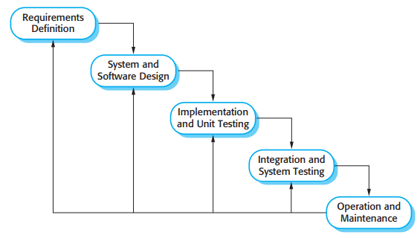
Software Process Model
The Waterfall model

Slide 22
Software Process Model
The Waterfall model
The principal stages of the waterfall model directly reflect the fundamental development activities:
1. Requirements analysis and definition: The system’s services, constraints, and goals are established by consultation with system users. They are then defined in detail and serve as a system specification.
2. System and software design: The systems design process allocates the requirements to either hardware or software systems by establishing an overall system architecture. Software design involves identifying and describing the fundamental software system abstractions and their relationships

Slide 23
Software Process Model
The Waterfall model
3. Implementation and unit testing: During this stage, the software design is realized as a set of programs or program units. Unit testing involves verifying that each unit meets its specification.
4. Integration and system testing: The individual program units or programs are integrated and tested as a complete system to ensure that the software requirements have been met. After testing, the software system is delivered to the customer.
5.Operation and maintenance: Normally (although not necessarily), this is the longest life cycle phase. The system is installed and put into practical use. Maintenance involves correcting errors which were not discovered in earlier stages of the life cycle, improving the implementation of system units and enhancing the system’s services as new requirements are discovered.

Slide 24
Software Process Model
The Waterfall model
In principle, the result of each phase is one or more documents that are approved (‘signed off’).
The following phase should not start until the previous phase has finished.
In practice, these stages overlap and feed information to each other.
During design, problems with requirements are identified. During coding, design problems are found and so on.
The software process is not a simple linear model but involves feedback from one phase to another.
Documents produced in each phase may then have to be modified to reflect the changes made

Slide 25
Software Process Model
The Waterfall model
During the final life cycle phase (operation and maintenance) the software is put into use.
Errors and omissions in the original software requirements are discovered.
Program and design errors emerge and the need for new functionality is identified.
The system must therefore evolve to remain useful. Making these changes (software maintenance) may involve repeating previous process stages.

Slide 26
Software Process Model
The Waterfall model
The waterfall model is consistent with other engineering process models and documentation is produced at each phase.
The waterfall model should only be used when the requirements are well understood and unlikely to change radically during system development.
The waterfall model reflects the type of process used in other engineering projects.
As is easier to use a common management model for the whole project, software processes based on the waterfall model are still commonly used.
This makes the process visible so managers can monitor progress against the development plan.

Slide 27
Software Process Model
The Waterfall model
Because of the costs of producing and approving documents, iterations can be costly and involve significant rework.
Therefore, after a small number of iterations, it is normal to freeze parts of the development, such as the specification, and to continue with the later development stages.
Problems are left for later resolution, ignored, or programmed around. This premature freezing of requirements may mean that the system won’t do what the user wants.
It may also lead to badly structured systems as design problems are circumvented by implementation tricks.

Slide 28
Software Process Model
The Waterfall model
Its major problem is the inflexible partitioning of the project into distinct stages. Commitments must be made at an early stage in the process, which makes it difficult to respond to changing customer requirements.

Slide 29
Software Process Model
Incremental Development
Incremental development is based on the idea of developing an initial implementation, exposing this to user comment and evolving it through several versions until an adequate system has been developed
Specification, development, and validation activities are interleaved rather than separate, with rapid feedback across activities

Slide 30
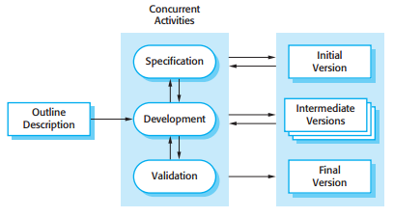
Software Process Model
Incremental Development

Slide 31
Software Process Model
Incremental Development
Incremental software development, which is a fundamental part of agile approaches.
Incremental development reflects the way that we solve problems.
By developing the software incrementally, it is cheaper and easier to make changes in the software as it is being developed.

Slide 32
Software Process Model
Incremental Development
Each increment or version of the system incorporates some of the functionality that is needed by the customer. Generally, the early increments of the system include the most important or most urgently required functionality. This means that the customer can evaluate the system at a relatively early stage in the development to see if it delivers what is required. If not, then only the current increment has to be changed and, possibly, new functionality defined for later increments

Slide 33
Software Process Model
Incremental Development
Incremental development has three important benefits:
The cost of accommodating changing customer requirements is reduced. The amount of analysis and documentation that has to be redone is much less than is required with the waterfall model.
It is easier to get customer feedback on the development work that has been done. Customers can comment on demonstrations of the software and see how much has been implemented. Customers find it difficult to judge progress from software design documents.

Slide 34
Software Process Model
Incremental Development
Incremental development has three important benefits:
More rapid delivery and deployment of useful software to the customer is possible, even if all of the functionality has not been included. Customers are able to use and gain value from the software earlier

Slide 35
Software Process Model
Incremental Development
Incremental development can be either plan-driven, agile, or, more usually, a mixture of these approaches.
In a plan-driven approach, the system increments are identified in advance; if an agile approach is adopted, the early increments are identified but the development of later increments depends on progress and customer priorities

Slide 36
Software Process Model
Incremental Development
The incremental approach has two problems:
The process is not visible. Managers need regular deliverables to measure progress. If systems are developed quickly, it is not cost-effective to produce documents that reflect every version of the system.
System structure tends to degrade as new increments are added. Unless time and money is spent on refactoring to improve the software, regular change tends to corrupt its structure. Incorporating further software changes becomes increasingly difficult and costly.

Slide 37
Software Process Model
Incremental Development
You can develop a system incrementally and expose it to customers for comment, without actually delivering it and deploying it in the customer’s environment. Incremental delivery and deployment means that the software is used in real, operational processes.

Slide 38
Software Process Model
Processing Activities
Real software processes are interleaved sequences of technical, collaborative, and managerial activities with the overall goal of specifying, designing, implementing, and testing a software system.

Slide 39
Software Process Model
Processing Activities
Real software processes are interleaved sequences of technical, collaborative, and managerial activities with the overall goal of specifying, designing, implementing, and testing a software system.

Slide 40
Software Process Model
Processing Activities
The four basic process activities of specification, development, validation, and evolution are organized differently in different development processes.
Software specification
Software design and implementation
Software validation
Software evolution

Slide 41
Software Process Model
Software specification
Software specification or requirements engineering is the process of understanding and defining what services are required from the system and identifying the constraints on the system’s operation and development.
Requirements engineering is a particularly critical stage of the software process as errors at this stage inevitably lead to later problems in the system design and implementation.

Slide 42
Software Process Model
Software specification
Requirements engineering process aims to produce an agreed requirements document that specifies a system satisfying stakeholder requirements.

Slide 43
Software Process Model
Software specification
Requirements are usually presented at two levels of detail:
End-users and customers need a high-level statement of the requirements
System developers need a more detailed system specification

Slide 44
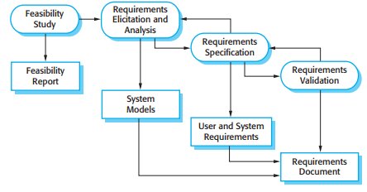
Software Process Model
Software specification
Requirements Engineering Process

Slide 45
Software Process Model
Software specification
Requirements Engineering Process
Feasibility study:
An estimate is made of whether the identified user needs may be satisfied using current software and hardware technologies. The study considers whether the proposed system will be cost-effective from a business point of view and if it can be developed within existing budgetary constraints.
A feasibility study should be relatively cheap and quick. The result should inform the decision of whether or not to go ahead with a more detailed analysis.

Slide 46
Software Process Model
Software specification
Requirements Engineering Process
Requirements elicitation and analysis:
This is the process of deriving the system requirements through observation of existing systems, discussions with potential users and procurers, task analysis, and so on.
This may involve the development of one or more system models and prototypes. These help you understand the system to be specified.

Slide 47
Software Process Model
Software specification
Requirements Engineering Process
Requirements specification:
Requirements specification is the activity of translating the information gathered during the analysis activity into a document that defines a set of requirements.
Two types of requirements may be included in this document:
User requirements are abstract statements of the system requirements for the customer and end-user of the system
System requirements are a more detailed description of the functionality to be provided.

Slide 48
Software Process Model
Software specification
Requirements Engineering Process
Requirements validation
This activity checks the requirements for realism, consistency, and completeness.
During this process, errors in the requirements document are inevitably discovered. It must then be modified to correct these problems.
In agile methods, such as extreme programming, requirements are developed incrementally according to user priorities and the elicitation of requirements comes from users who are part of the development team.

Slide 49
Software Process Model
Software design and implementation
The implementation stage of software development is the process of converting a system specification into an executable system.
It always involves processes of software design and programming, may also involve refinement of the software specification.
A software design is a description of the structure of the software to be implemented, the data models and structures used by the system, the interfaces between system components and, sometimes, the algorithms used.

Slide 50
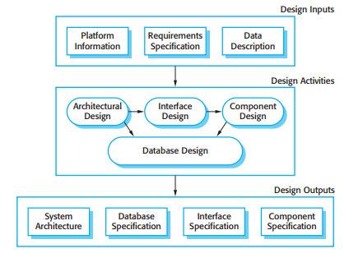
Software Process Model
Software design and implementation
The diagram suggests that the stages of the design process are sequential. In fact, design process activities are interleaved. Feedback from one stage to another and consequent design rework is inevitable in all design processes

Slide 51
Software Process Model
Software design and implementation
Information about the platform is an essential input to the design process, as designers must decide how best to integrate it with the software’s environment.
The requirements specification is a description of the functionality the software must provide and its performance and dependability requirements.
If the system is to process existing data, then the description of that data may be included in the platform specification; otherwise, the data description must be an input to the design process so that the system data organization to be defined.
The activities in the design process vary, depending on the type of system being developed.

Slide 52
Software Process Model
Software design and implementation
Architectural design:
where you identify the overall structure of the system, the principal components (sometimes called sub-systems or modules), their relationships, and how they are distributed.
Interface design:
where you define the interfaces between system components. This interface specification must be unambiguous. With a precise interface, a component can be used without other components having to know how it is implemented. Once interface specifications are agreed, the components can be designed and developed concurrently

Slide 53
Software Process Model
Software design and implementation
Component design:
where you take each system component and design how it will operate. This may be a simple statement of the expected functionality to be implemented, with the specific design left to the programmer. Alternatively, it may be a list of changes to be made to a reusable component or a detailed design model. The design model may be used to automatically generate an implementation.
Database design:
where you design the system data structures and how these are to be represented in a database. Again, the work here depends on whether an existing database is to be reused or a new database is to be created.

Slide 54
Software Process Model
Software design and implementation
The development of a program to implement the system follows naturally from the system design processes.
Software development tools may be used to generate a skeleton program from a design. This includes code to define and implement interfaces, and, in many cases, the developer need only add details of the operation of each program component.

Slide 55
Software Process Model
Software design and implementation
Normally, programmers carry out some testing of the code they have developed. This often reveals program defects that must be removed from the program. This is called debugging.
Defect testing and debugging are different processes.
Testing establishes the existence of defects.
Debugging is concerned with locating and correcting these defects.
When you are debugging, you have to generate hypotheses about the observable behavior of the program then test these hypotheses in the hope of finding the fault that caused the output anomaly.
Testing the hypotheses may involve tracing the program code manually. It may require new test cases to localize the problem..

Slide 56
Software Process Model
Software validation
Software validation or, more generally, verification and validation (V&V) is intended to show that a system both conforms to its specification and that it meets the expectations of the system customer.
Program testing, where the system is executed using simulated test data, is the principal validation technique.
Validation may also involve checking processes, such as inspections and reviews, at each stage of the software process from user requirements definition to program development.
Because of the predominance of testing, the majority of validation costs are incurred during and after implementation.

Slide 57

Software Process Model
Software validation
Three Stage of testing
Three-stage testing process in which system components are tested then the integrated system is tested and, finally, the system is tested with the customer’s data.
Ideally, component defects are discovered early in the process, and interface problems are found when the system is integrated.
However, as defects are discovered, the program must be debugged and this may require other stages in the testing process to be repeated. Errors in program components, say, may come to light during system testing.
The process is therefore an iterative one with information being fed back from later stages to earlier parts of the process.

Slide 58
Software Process Model
Software validation
Development testing:
The components making up the system are tested by the people developing the system. Each component is tested independently, without other system components. Components may be simple entities such as function or object classes, or may be coherent groupings of these entities.
e.g Test automation tools, such as JUnit (Massol and Husted, 2003), that can re-run component tests when new versions of the component are created, are commonly used.

Slide 59
Software Process Model
Software validation
System testing
System components are integrated to create a complete system.
This process is concerned with finding errors that result from unanticipated interactions between components and component interface problems.
It is also concerned with showing that the system meets its functional and non-functional requirements, and testing the emergent system properties.
For large systems, this may be a multi-stage process where components are integrated to form subsystems that are individually tested before these sub-systems are themselves integrated to form the final system.

Slide 60
Software Process Model
Software validation
Acceptance testing
This is the final stage in the testing process before the system is accepted for operational use.
The system is tested with data supplied by the system customer rather than with simulated test data.
Acceptance testing may reveal errors and omissions in the system requirements definition, because the real data exercise the system in different ways from the test data.
Acceptance testing may also reveal requirements problems where the system’s facilities do not really meet the user’s needs or the system performance is unacceptable.
Acceptance testing is sometimes called ‘alpha testing’. Custom systems are developed for a single client. The alpha testing process continues until the system developer and the client agree that the delivered system is an acceptable implementation of the requirements.

Slide 61
Software Process Model
Software validation
Normally, component development and testing processes are interleaved. Programmers make up their own test data and incrementally test the code as it is developed.
If an incremental approach to development is used, each increment should be tested as it is developed, with these tests based on the requirements for that increment. In extreme programming, tests are developed along with the requirements before development starts. This helps the testers and developers to understand the requirements and ensures that there are no delays as test cases are created.

Slide 62
Software Process Model
Software validation
If an incremental approach to development is used, each increment should be tested as it is developed, with these tests based on the requirements for that increment. In extreme programming, tests are developed along with the requirements before development starts. This helps the testers and developers to understand the requirements and ensures that there are no delays as test cases are created.

Slide 63
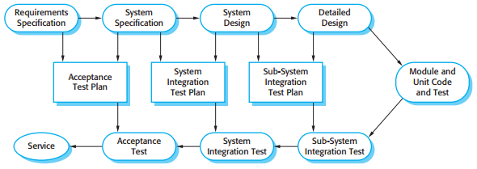
Software Process Model
Software validation
Testing phases in a plan-driven

Slide 64
Software Process Model
Software validation
When a plan-driven software process is used (e.g., for critical systems development), testing is driven by a set of test plans. An independent team of testers works from these pre-formulated test plans, which have been developed from the system specification and design.
This is sometimes called the V-model of development (turn it on its side to see the V).

Slide 65
Software Process Model
Software validation
Acceptance testing is sometimes called ‘alpha testing’. Custom systems are developed for a single client. The alpha testing process continues until the system developer and the client agree that the delivered system is an acceptable implementation of the requirements.
When a system is to be marketed as a software product, a testing process called ‘beta testing’ is often used. Beta testing involves delivering a system to a number of potential customers who agree to use that system. They report problems to the system developers. This exposes the product to real use and detects errors that may not have been anticipated by the system builders. After this feedback, the system is modified and released either for further beta testing or for general sale.

Slide 66
Software Process Model
Software evolution
This distinction between development and maintenance is increasingly irrelevant.
Hardly any software systems are completely new systems and it makes much more sense to see development and maintenance as a continuum.
Rather than two separate processes, it is more realistic to think of software engineering as an evolutionary process where software is continually changed over its lifetime in response to changing requirements and customer needs.

Slide 67
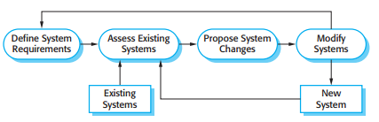
Software Process Model
Software evolution
System evolution

Slide 68
Software Process Model
Copying with change
Change is inevitable in all large software projects. The system requirements change as the business procuring the system responds to external pressures and management priorities change.
As new technologies become available, new design and implementation possibilities emerge. Therefore whatever software process model is used, it is essential that it can accommodate changes to the software being developed.
Change adds to the costs of software development because it usually means that work that has been completed has to be redone. This is called rework.

Slide 69
Software Process Model
Copying with change
There are two related approaches that may be used to reduce the costs of rework:
Change avoidance
where the software process includes activities that can anticipate possible changes before significant rework is required.
For example, a prototype system may be developed to show some key features of the system to customers. They can experiment with the prototype and refine their requirements before committing to high software production costs.

Slide 70
Software Process Model
Copying with change
There are two related approaches that may be used to reduce the costs of rework:
Change tolerance:
where the process is designed so that changes can be accommodated at relatively low cost. This normally involves some form of incremental development. Proposed changes may be implemented in increments that have not yet been developed. If this is impossible, then only a single increment (a small part of the system) may have to be altered to incorporate the change.

Slide 71
Software Process Model
Copying with change
Two ways of coping with change and changing system requirements. These are:
1. System prototyping:
where a version of the system or part of the system is developed quickly to check the customer’s requirements and the feasibility of some design decisions.
This supports change avoidance as it allows users to experiment with the system before delivery and so refine their requirements.
The number of requirements change proposals made after delivery is therefore likely to be reduced.

Slide 72
Software Process Model
Copying with change
2. Incremental delivery:
Where system increments are delivered to the customer for comment and experimentation.
This supports both change avoidance and change tolerance.
It avoids the premature commitment to requirements for the whole system and allows changes to be incorporated into later increments at relatively low cost.

Slide 73
Software Process Model
The Rational Unified Process
The Rational Unified Process (RUP) is an example of a modern process model that has been derived from work on the UML and the associated Unified Software Development Process.
The RUP recognizes that conventional process models present a single view of the process.
RUP is normally described from three perspectives:
A dynamic perspective, which shows the phases of the model over time.
A static perspective, which shows the process activities that are enacted.
A practice perspective, which suggests good practices to be used during the process.

Slide 74
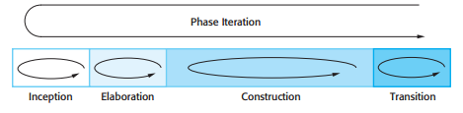
Software Process Model
The Rational Unified Process
The RUP is a phased model that identifies four discrete phases in the software process.
(Phases are equated with process activities, the phases in the RUP are more closely related to business rather than technical concerns)
Phases in the Rational Unified Process

Slide 75
Software Process Model
The Rational Unified Process
Inception
The goal of the inception phase is to establish a business case for the system.
You should identify all external entities (people and systems) that will interact with the system and define these interactions.
You then use this information to assess the contribution that the system makes to the business.
If this contribution is minor, then the project may be cancelled after this phase.

Slide 76
Software Process Model
The Rational Unified Process
2. Elaboration
The goals of the elaboration phase are to develop an understanding of the problem domain, establish an architectural framework for the system, develop the project plan, and identify key project risks.
On completion of this phase you should have a requirements model for the system, which may be a set of UML use-cases, an architectural description, and a development plan for the software

Slide 77
Software Process Model
The Rational Unified Process
3. Construction
The construction phase involves system design, programming, and testing.
Parts of the system are developed in parallel and integrated during this phase.
On completion of this phase, you should have a working software system and associated documentation that is ready for delivery to users.

Slide 78
Software Process Model
The Rational Unified Process
4. Transition
The final phase of the RUP is concerned with moving the system from the development community to the user community and making it work in a real environment.
This is something that is ignored in most software process models but is, in fact, an expensive and sometimes problematic activity.
On completion of this phase, you should have a documents

Slide 79
Software Process Model
The Rational Unified Process
Iteration within the RUP is supported in two ways.
Each phase may be enacted in an iterative way with the results developed incrementally.
In addition, the whole set of phases may also be enacted incrementally
Note:
The RUP is not a suitable process for all types of development, e.g., embedded software development

Slide 80
Software Process Model
The Rational Unified Process
The static view of the RUP focuses on the activities that take place during the development process.
These are called workflows in the RUP description.
There are six core process workflows identified in the process and three core supporting workflows.
The RUP has been designed in conjunction with the UML, so the workflow description is oriented around associated UML models such as sequence models, object models, etc.

Slide 81
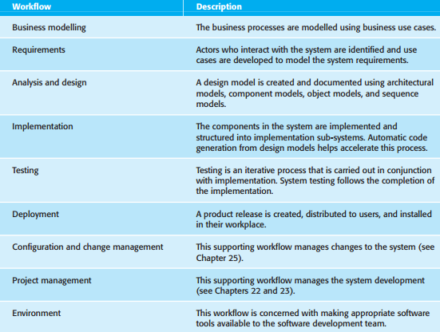
Software Process Model
The Rational Unified Process
The core engineering and support workflows are described as

Slide 82
Software Process Model
The Rational Unified Process
The advantage in presenting dynamic and static views is that phases of the development process are not associated with specific workflows.
In principle at least, all of the RUP workflows may be active at all stages of the process. In the early phases of the process, most effort will probably be spent on workflows such as business modeling and requirements and, in the later phases, in testing and deployment.

Slide 83
Software Process Model
The Rational Unified Process
The practice perspective on the RUP describes good software engineering practices that are recommended for use in systems development.
Six fundamental best practices are recommended:
Develop software iteratively
Manage requirements
Use component-based architectures
Visually model software
Verify software quality
Control changes to software

Slide 84
Software Process Model
The Rational Unified Process
Develop software iteratively
Plan increments of the system based on customer priorities and develop the highest-priority system features early in the development process.
2. Manage requirements
Explicitly document the customer’s requirements and keep track of changes to these requirements. Analyze the impact of changes on the system before accepting them.

Slide 85
Software Process Model
The Rational Unified Process
3. Use component-based architectures
Structure the system architecture into components.
4. Visually model software
Use graphical UML models to present static and dynamic views of the software.
5. Verify software quality
Ensure that the software meets the organizational quality standards
6. Control changes to software
Manage changes to the software using a change management system and configuration management procedures and tools.

